Slide 1
DBMS PRESENTATION 3
Exam Scheduling and Result Processing System
Frontend & Backend Implementation
HTML • CSS • JavaScript • Flask • MySQL
A DBMS web application connecting a user-friendly interface to a relational database.

Slide 2
1. Frontend–Backend Architecture
How the application connects the browser, Flask and MySQL
Frontend
Flask Backend
MySQL Database
HTML forms
CSS styling
Jinja templates
JavaScript interactions
Routes
Request handling
Validation
SQL execution
Relational tables
Primary/foreign keys
Persistent data
CRUD queries
Browser → HTTP request → Flask route → SQL query → MySQL → Flask response → HTML page

Slide 3
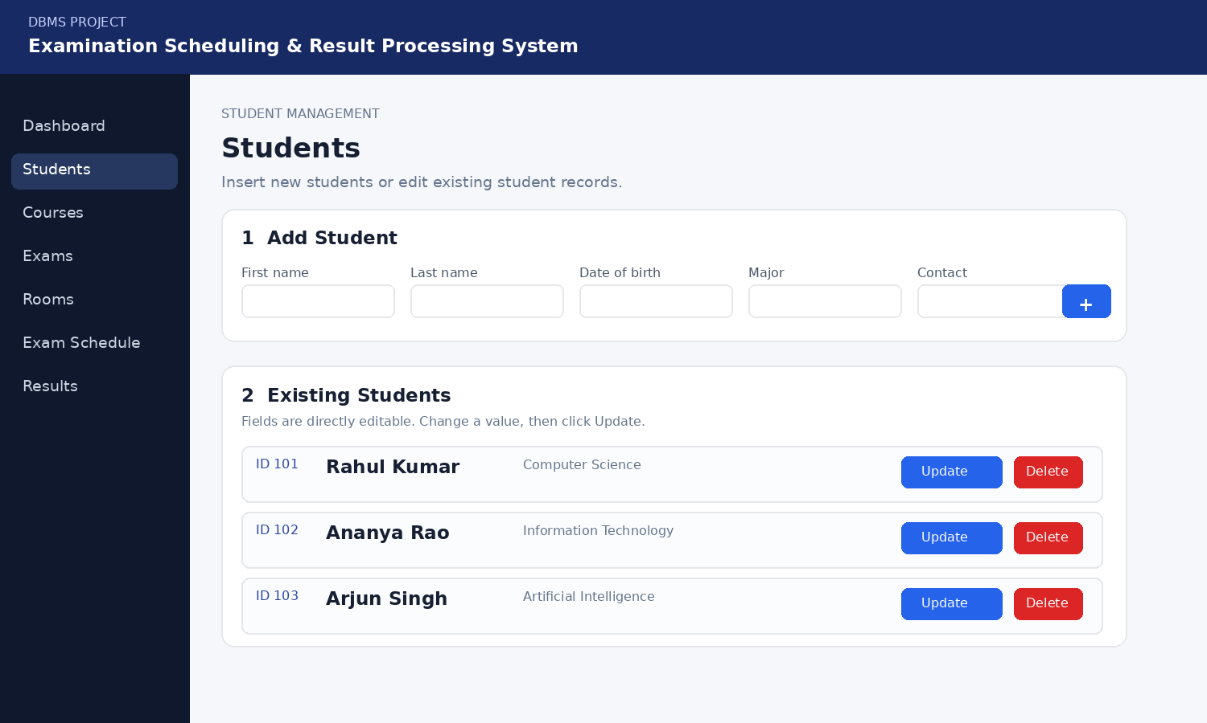
2. Frontend: User Interface
The frontend provides the forms and controls used to interact with the database.
HTML + Jinja
CSS
User Interaction
Separate pages for Students, Courses, Exams, Rooms, Schedule and Results.
Jinja inserts database records into templates.
Card-based layout
Responsive forms
Navigation sidebar
Clear CRUD buttons
Success/error messages
INSERT through forms
UPDATE through editable fields
DELETE through action buttons
SELECT through displayed records
Example: Student management interface

Slide 4
3. Backend: Python Flask
Flask acts as the application layer between the UI and MySQL.
Routes
Database Logic
Templates
Examples:
/students
/courses
/exams
/schedule
/results
Each route handles a module.
Flask receives form data and executes SQL.
INSERT → add record
SELECT → display records
UPDATE → edit record
DELETE → remove record
render_template() sends data to Jinja templates.
The backend passes database results to HTML and returns the rendered page to the browser.

Slide 5
4. Backend–Database Connectivity
Flask connects to the MySQL database named project.
DB_CONFIG = {
"host": "localhost",
"user": "flaskuser",
"password": "********",
"database": "project"
}
db = mysql.connector.connect(**DB_CONFIG)
Why this connection matters
• Data persists in MySQL
• Multiple pages use the same database
• CRUD actions directly affect stored records
• Relationships are maintained by database keys
Security note: credentials should be stored in environment variables in a production deployment.

Slide 6
5. CRUD Flow in the Project
The same frontend-to-backend pattern is used across all major modules.
INSERT
Form submits new values
→
Flask executes INSERT
→
New row stored
SELECT
Page requests records
→
Flask executes SELECT
→
Rows displayed
UPDATE
User edits fields
→
Flask executes UPDATE
→
Existing row changed
DELETE
User clicks Delete
→
Flask executes DELETE
→
Row removed
Modules using CRUD
Students • Courses • Exams • Rooms • Exam Schedule • Results

Slide 7
6. Conclusion
Frontend + Backend + Database
Frontend
Backend
Database
Provides a clear interface for users to perform CRUD operations.
Flask connects user actions to application logic and SQL queries.
MySQL stores structured examination data and relationships.
The project demonstrates how a relational DBMS can be integrated into a complete web application.
Thank You

